Slide 1
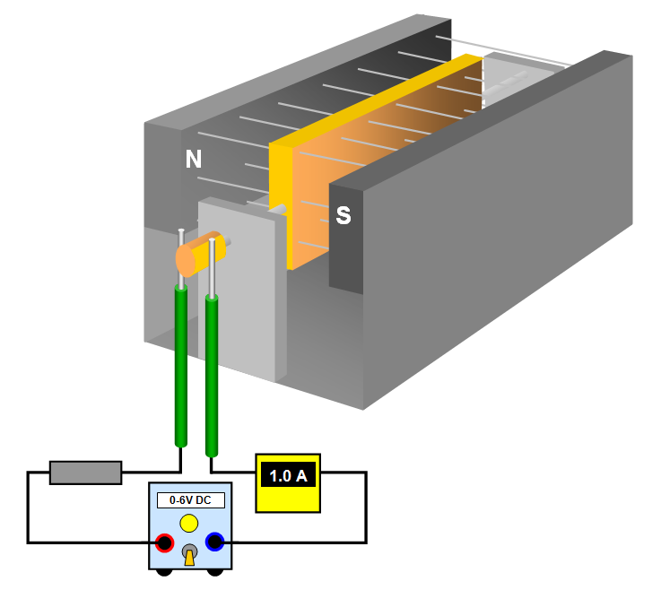
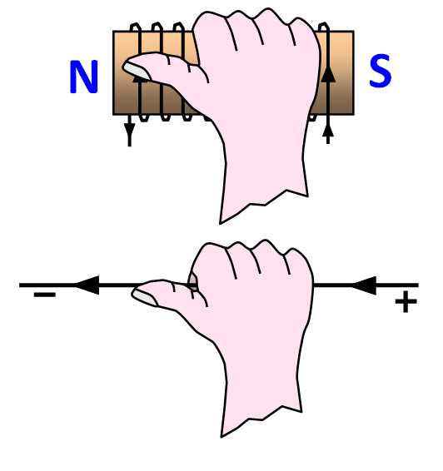
Magnetism and Electromagnetism (11-16)

Slide 2
Contents
Topic | Page |  | Topic | Page
Magnetism | 3 |  | Carbon microphone | 15
Inside a magnet | 4 |  | Electric bell | 16
Making a magnet | 5 |  | Electric motor (1) | 17
Magnetic fields | 6 |  | Electric motor (2) | 18
Magnetic field of the Earth | 7 |  | Electric motor (3) | 19
Magnetic field strengths | 8 |  | Electromagnet | 20
Electromagnetic fields | 9 |  | Electromagnet - polarity | 21
Force on a current | 10 |  | Polarity of electromagnets | 22
Fleming’s left hand rule | 11 |  | Loudspeaker | 23
Catapult field | 12 |  | Relay | 24
Catapult field (2) | 13 |  |  | 25
Force on a coil | 14 |  |  | 26

Slide 3
Magnetism
Magnetism was discovered by the Greeks in about 600 BC. They noticed that a substance called lodestone had some strange properties. If a piece of lodestone was hung on a thread it would always point in the same direction.
The following materials can be magnetized and attracted by a magnet:
iron steel cobalt nickel
A magnet has two POLES, these are the places where its magnetism is greatest; in a bar magnet the poles are close to the ends of the magnet.
A north pole repels another north pole.
A south pole repels another south pole.
A north pole and a south pole will attract each other.
Like poles repel each other
Unlike poles attract each other

Slide 4
Inside a magnet
If a magnet is cut in half each half will be a small magnet.
N S
N S
N S
N S
N S
N S
N S
Inside a bar of magnetic material there are millions of tiny magnets. When the bar is not magnetised these are joined in closed loops (i). As the bar is magnetised these split up (ii) and (iii) and when it is fully magnetised they are arranged in an orderly way, all pointing in one direction (iv).
(i)
(ii)
(iii)
(iv)

Slide 5
Making a magnet
S
(a) Stroking it with a magnet to ‘draw’ all the like poles to one end.
magnet
N
N
S
iron
(b) Winding a coil of wire round it and then passing a current (d.c. or ac.) through the wire.
iron
Banging a magnet will eventually destroy its magnetism as the regular arrangement of molecular magnets has been upset. It can also be can be demagnetized by heating it or slowly removing it from an ac. field.

Slide 6
Magnetic fields
The closer the magentic fields lines the stronger the magnetic field at that point.
If the magnetic field lines are the same distance apart throughout the field it is called a uniform field.
N
S
N
S
N
P
N
N
S
unlike pole attraction like pole repulsion

Slide 7
Magnetic field of the Earth
Geographic north pole
The shape of the Earth's magnetic field can be explained if you imagine a bar magnet placed at the centre of the Earth.
Magnetic north pole
S
N
The diagram is simplified
We now believe that the Earth's magnetic field is produced by electric currents flowing over 2800 km below us in the outer part of the Earth's core.

Slide 8
Magnetic field strengths
Magnetic fields are measured in units called Teslas (T). The strength of the large U shaped magnet used in many schools is about 1 T. The following list gives you an idea of the strengths of some other magnetic fields across the Universe.
(a) magnetic field due to the human heart 0.05 nT
(b) in the Galaxy 0.5 nT
(c) in the Crab nebula 0.01 mT
(d) Earth's magnetic field 18 mT
(e) Sun 20 mT at the surface
(f) surface of Jupiter 400 mT
(g) small permanent magnet in a lab 0.1 T
(h) large permanent magnet in a lab 1 T
(i) deflecting magnets in LEP (CERN Geneva) 0.5 T
(j) MRI scanner 2 T
(k) JET fusion reactor magnetic confinement 3.45 T
(l) superconducting solenoid 20 T
(m) white dwarfs 100 - 10 000 T
(n) near a pulsar (rotating neutron star) 100 000 000 T
(o) near a magnetar (a special type of neutron star) 10 000 million T

Slide 9
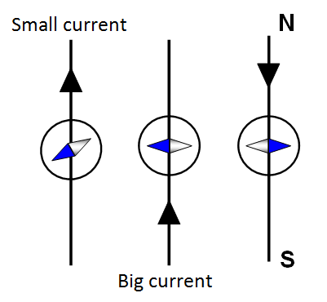
Electromagnetic field
When a current flows through a wire a magnetic field is produced around the wire. This field is called an electromagnetic field and the device produced is called an electromagnet. If the wire is wrapped round into a coil the magnetic field is stronger.
You can find the direction of the magnetic field produced by a wire by putting a small compass near the wire.
When a current is passed through the wire the compass needle will turn. The greater the current in the wire the more the compass needle moved. This experiment was first done by a man called Oersted in 1819 who made the discovery by accident.

Slide 10
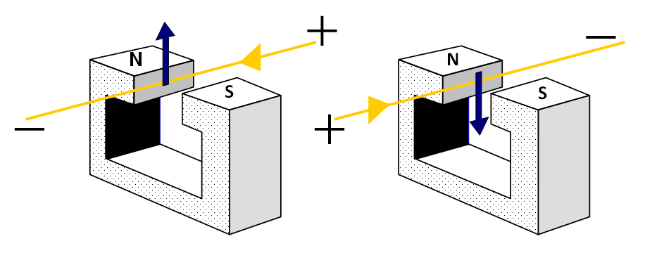
Force on a current in a magnetic field
If a wire carrying an electric current is placed in a magnetic field there is a force on the wire; and, if it could, it moved. This happens because of the combined effects of the magnetic fields of the wire and the magnets. Altering either the direction of the current or the direction of the magnetic field will change the direction of motion.
The bigger the current and the stronger the magnetic field the greater the force on the wire and the faster it will move. Also the wire will ‘feel’ the biggest force if it is at right angles to the magnetic field and no force at all if it is parallel to the field.

Slide 11
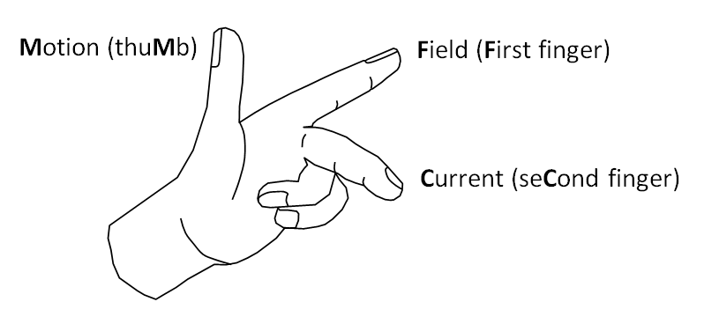
Fleming’s left hand rule
A simple way of remembering the direction of motion using your left hand is Fleming’s Left Hand Rule. If the thumb, first finger and second finger of the left hand are placed at right angles to each other:

Slide 12
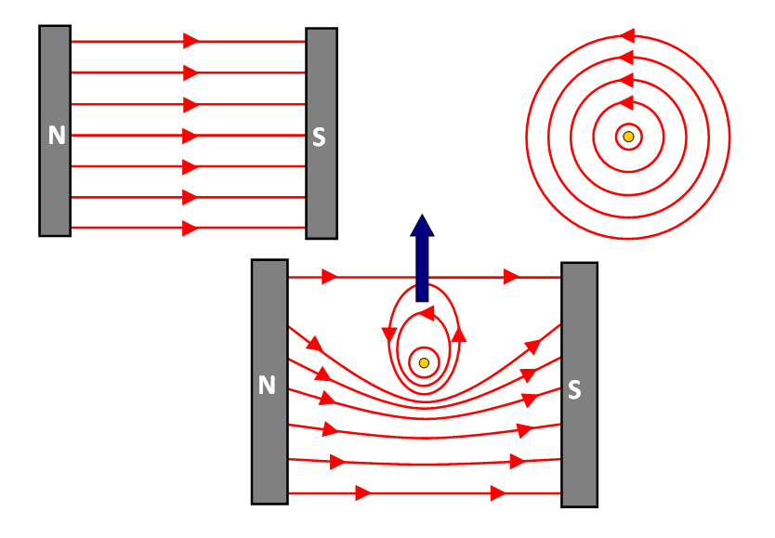
Catapult field
The diagrams show the field of two flat magnets (i), the field of a wire (ii), and the result of putting the wire and magnets together (iii). It is this third field that is called the catapult field. You can see that the magnetic lines of force are close together near the wire so forcing it upwards.

Slide 13
Catapult field (2)
A more accurate and detailed version of the catapult field.
It shows a neutral point where the fields of the wire and permanent magnets are balanced.
wire
S N
S N
neutral point

Slide 14
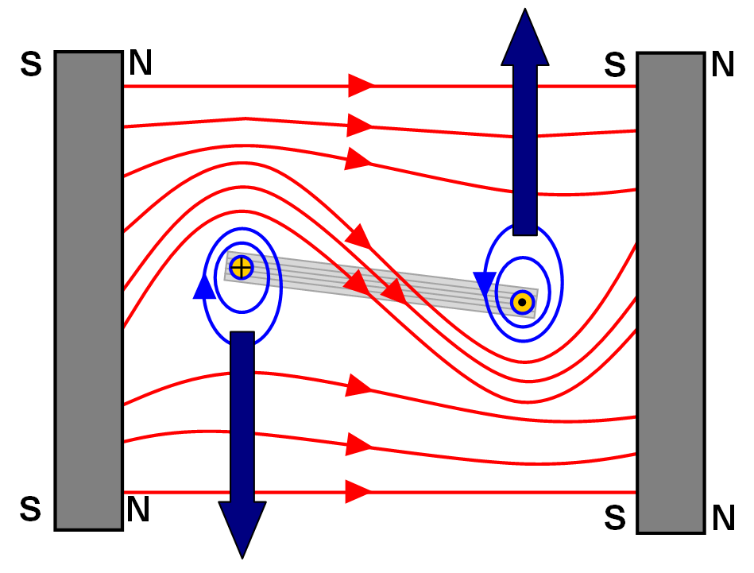
Forces on a coil in a magnetic field
If a current flows round a coil the way the current direction along one side of the coil will be opposite to that along the other side. If the coil is placed in a magnetic field the forces on each side of the coil will be opposite to each other.
This means that side of the coil will be pushed upwards and the other side pushed downwards and so the coil will twist.

Slide 15
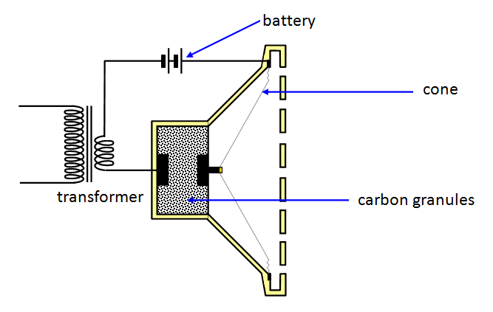
Carbon microphone
A battery passes a small current through the carbon granules. When a sound wave hits the front of the microphone the pressure on the carbon granules changes in step with the sound wave. This causes the resistance of the granules to change and therefore the current through them also changes (the battery voltage stays the same). This changing current is fed to a transformer and the output goes to an amplifier and a loudspeaker.

Slide 16
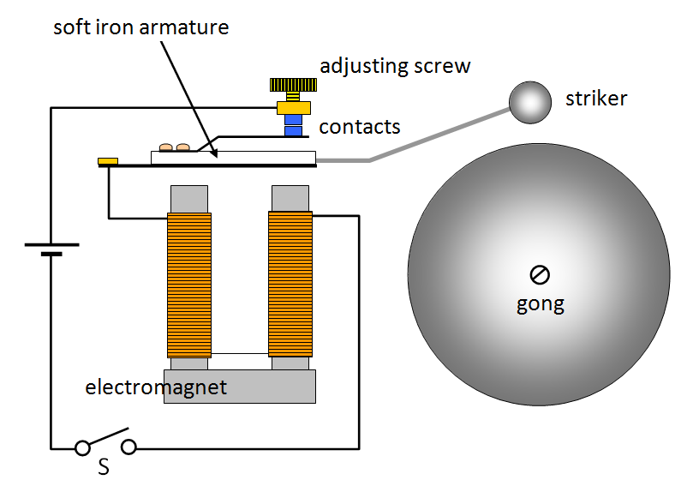
Electric bell
When the switch S is closed current flows through the electromagnet, along the spring, through the contacts, through the adjusting screw and back to the battery again. The electromagnet therefore attracts the soft iron armature and the striker hits the gong once. As soon as the armature is attracted the contacts are opened and so the current stops flowing.
This switches off the electromagnet, the spring pulls the armature away, the contacts meet again and so the current starts flowing again. This is repeated over and over again and so the bell rings.

Slide 17
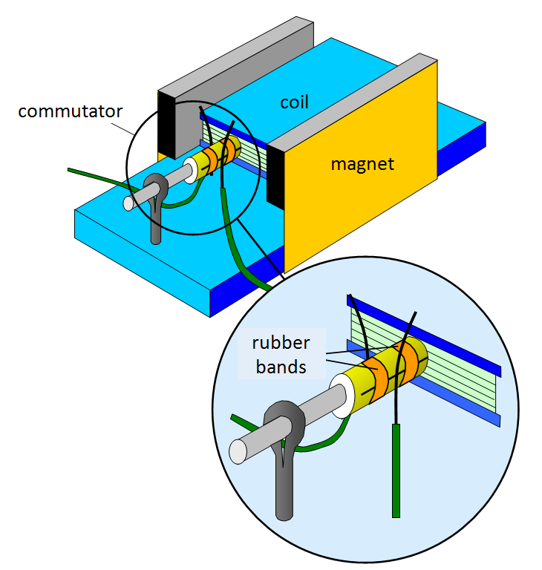
Electric motor (1)
An electric motor needs three things to make it work:
1. a magnetic field
2. a coil of wire with a current flowing through it
3. a means of getting this current in and out of the coil.
When a wire carrying a current is in a magnetic field there is a force on it at right angles to the field. (See the catapult field and Fleming’s left hand rule.)
A coil in a magnetic field experiences an equal but opposite force on its two sides and so the coil twists.

Slide 18
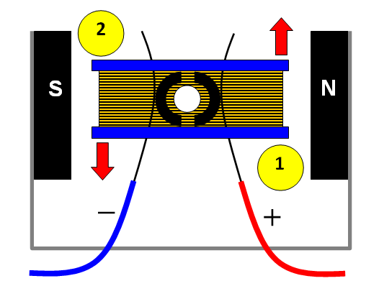
Electric motor (2)
When a current flows through the coil there is a force on the coil. The side marked 1 is forced upwards and the side marked 2 is forced downwards.
The coil turns in an ANTICLOCKWISE DIRECTION. The inertia of the coil keeps it turning between each contact with the input wires (+ and -).
To make the motor turn faster we can:
(a) increase the current
(b) replace the magnets with more powerful ones
(c) push the magnets closer to the coil
(d) put an iron centre piece into the coil
(e) add more sets of coils around the central core

Slide 19
Electric motor (3)
N
S
1.0 A
0-6V DC

Slide 20
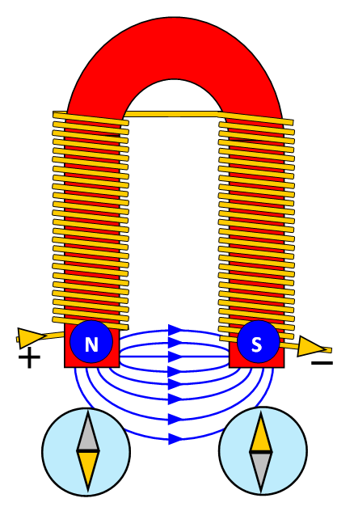
Electromagnet
An electromagnet be made stronger by:
(a) more coils
(b) more current
(c) coils closer together
(d) putting an iron core in the centre of the coil
(e) bending the poles of the magnet closer together to make a U shaped magnet

Slide 21
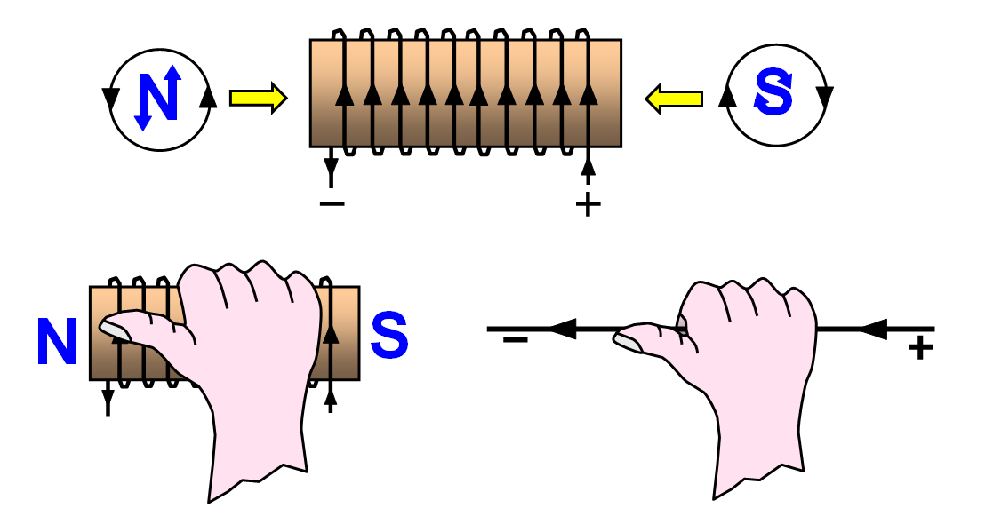
Electromagnet - polarity
(a) Direction of the current round the ends of the coil of wire. Look at the ends of the coil from the outside; the direction of the current follows the direction of the letters N and S for north and south
(b) the right hand grip rule
(i) for a solenoid
If you imagine gripping the solenoid with your right hand so that your fingers follow the direction of the current your thumb will point towards the NORTH end of the electromagnet
(ii) for a straight wire
If you imagine griping the wire with your right hand with your thumb in the direction of the current then your fingers will show the direction of the magnetic field round the wire pointing from NORTH to SOUTH.

Slide 22
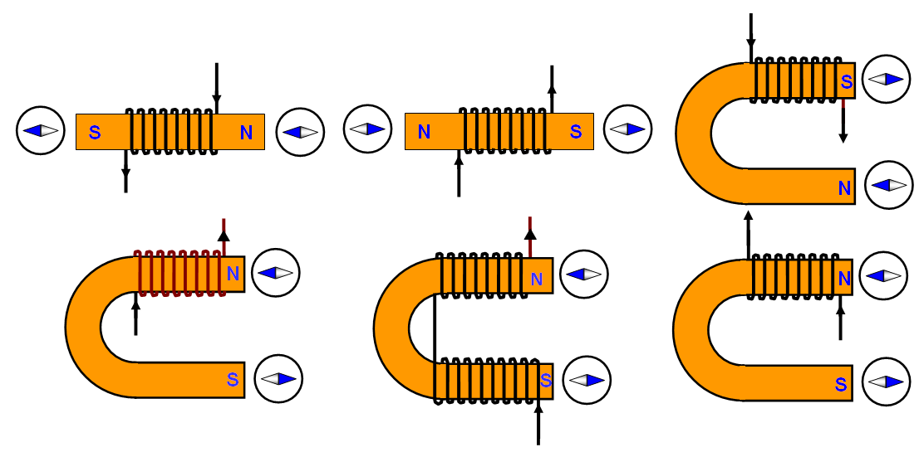
Polarity of electromagnets
You can use a small compass to test the polarity of an electromagnet. The following diagrams show the result of doing this for different current directions, different shaped cores and different ways of winding the wire round the core.

Slide 23
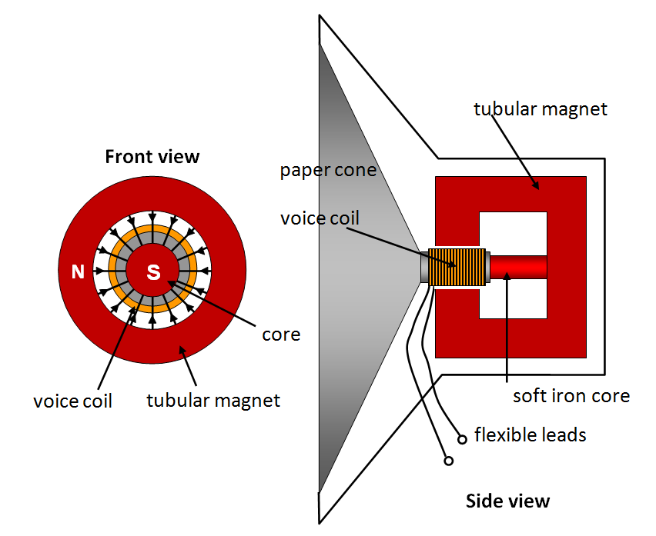
The loudspeaker
The current in the coil makes it a magnet and so it is affected by the field of the speaker magnet. The force on the coil makes it move at right angles to the magnetic field – that is in and out of the paper in the first diagram.
Since the signal is a.c. the force on the coil is changing and so it moves backwards and forwards, this in turn makes the speaker cone vibrate giving you the sound.

Slide 24
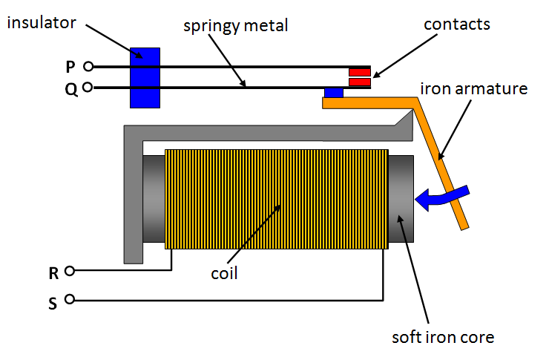
The relay
To switch on the relay a small current must flow in the circuit RS. When this happens the coil and soft iron core become an electromagnet. The iron armature is attracted to it - the contacts are closed and so the circuit PQ (large current) is made.

